Slide 1
Computer Graphics
Lecture-1
Introduction
Advantages
Areas of Application

Slide 2
Introduction
Computer graphics involves display, manipulation data for proper visualization using computer.
Generate 2D images of a 3D world represented in a computer.
Main tasks:
Modeling: creating and representing the geometry of objects in the 3D world
Rendering: generating 2D images of the objects
Animation: describing how objects change in time

Slide 3
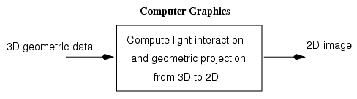

Slide 4
Typical graphical system consists of host computer with support of fast processor , large memory ,frame buffer and
Display devices(Monitors)
Input devices(keyboards, mouse , joysticks)
Output devices(printers, plotters, LCD panel)

Slide 5
Interactive Graphics System
Application
Model
Application
Program
Graphics
System
Display Unit
Input Unit

Slide 6
Designer of computer graphics system or software engineer puts his design in application model.
He will then writes the program to model the object he is planning to display.
This application will run on the computer graphics system and output will be displayed on the display devices and the required input can be obtained from the input devices.

Slide 7
Advantages
High quality graphics display provide best way to communicate with computer.
It is possible to produce animation.
Can be used to control animation such as speed, total scene in view etc.
Provides facility of update dynamic which can be used to change shape , color and other properties of object in view.
With the development in DSP it can provide audio feedback along with the video.

Slide 8
Application Areas
Computer Aided Design(CAD)
Presentation Graphics
Computer Art
Education and training
Visualization
Image processing
Entertainment
Movies Industry
Gaming Industry
Medical field
Graphical User Interface(GUI)

Slide 9
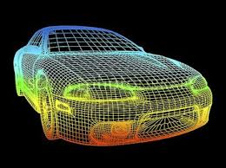
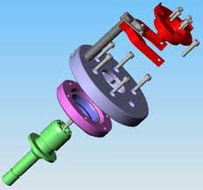
CAD
Major use of computer graphics is in design process, particularly for engineering and architectural systems.
This include design of buildings, automobiles, aircraft etc.

Slide 10
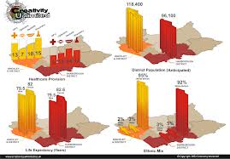
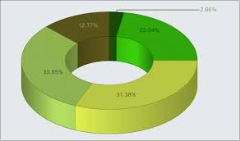
Presentation Graphics
Used to summarize the financial, mathematical, scientific and economic data.
Typical examples are bar charts, line graphs, pie charts etc.

Slide 11


Computer Art
Artist uses special purpose hardware and programs that provides facilities for designing object shapes and specifying object motion.
Examples pixel paint, super paint etc.

Slide 12
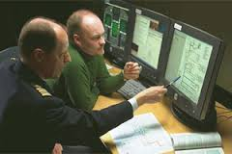
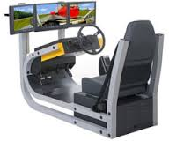
Education and training
Computer generated models of physical, financial and economic system are often used as educational aids.
Various kinds of simulators program can be used to provide the trainings. E.g. automobile driving simulator.

Slide 13
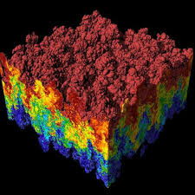
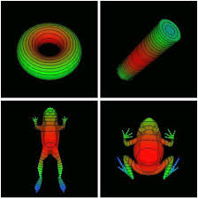
Visualization
Various techniques can be used to represent the large amount of data obtained from scientific , medical or business analysis.
These includes color coding, contour plots, graphs , charts etc.

Slide 14
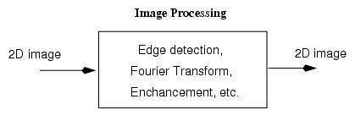
Image Processing
Computer graphics is used to create pictures.
Image processing applies techniques to modify or interpret the existing pictures.
It is used to:
Improve picture quality
Machine perception of visual information

Slide 15
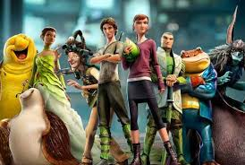
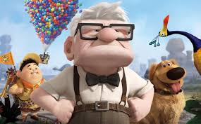
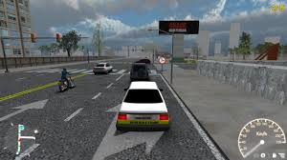
Entertainment
Computer graphics methods are now commonly used in making motion pictures, music videos , games and televisions shows.
Sometime graphics pictures are displayed by themselves and sometime combined with the actors and live scenes.

Slide 16
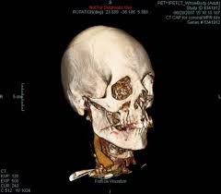
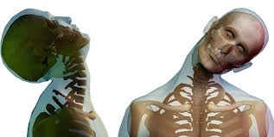
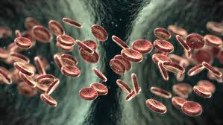
Medical Field
Computer graphics can also be used to represent the various internal parts and process of the human body.

Slide 17
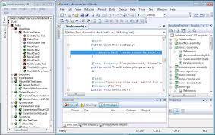
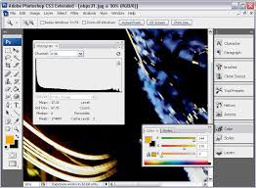
GUI
It is the interface of the software that communicates with the user with help of some input devices.
It contains number of windows , menus and icons for fast selection of processing options.

Slide 18
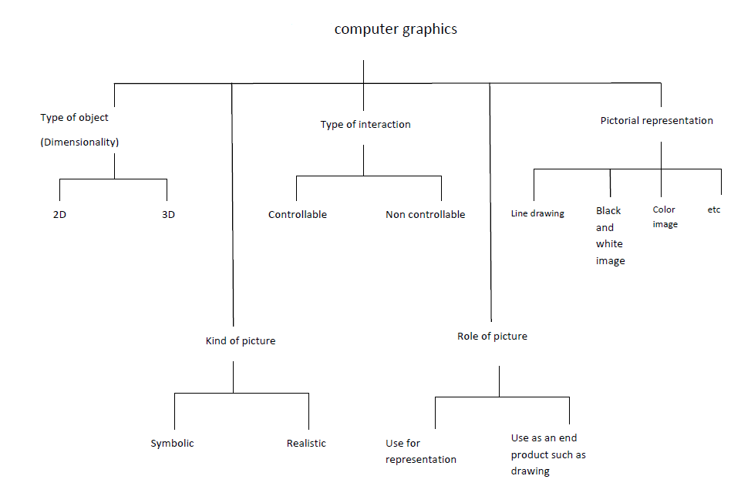

Slide 19
Vector and Raster Graphics
The difference between vector and raster graphics is that raster graphics are composed of pixels, while vector graphics are composed of paths.
A raster graphic, such as a gif or jpeg, is an array of pixels of various colors, which together form an image.
A vector graphic, such as an .eps file or Adobe Illustrator file, is composed of paths, or lines, that are either straight or curved.

Slide 20
Difference Between Raster Graphics and Vector Graphics
Raster Graphics | Vector Graphics
Defined by pixels | Defined by mathematical equations(lines & curves)
Non-scaleable | Scaleable to any size
Resolution dependent | Independent of resolution
Continuous tone, photographic qualities | Cartoon-like, line drawing qualities
Always use for photos | Always use for logos, text
Raster images are quite heavier than their vector peers. | Vector images are quite lighter than their raster peers.

Slide 21
Advantages of Raster Graphics
Advantages : Data can be represented at its original resolution and form without generalization. Graphic output is usually more aesthetically pleasing.

Slide 22
Thank You

